Slide 1
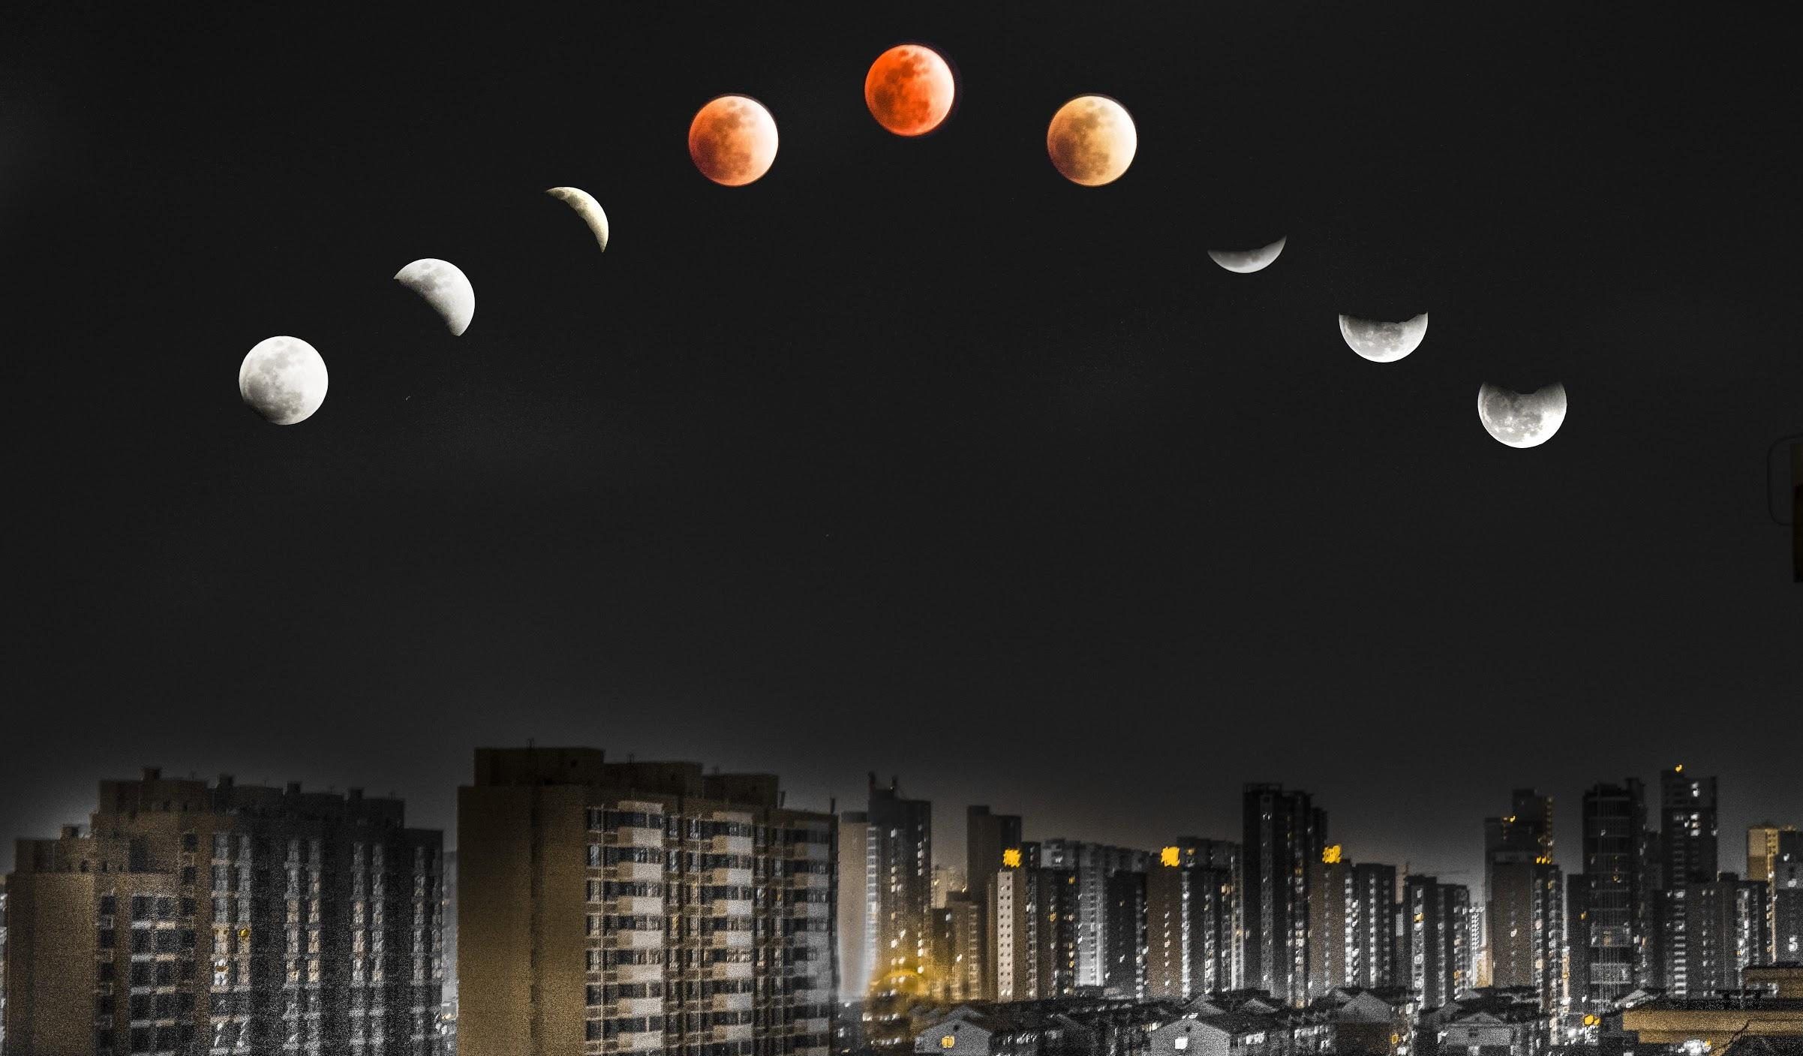
MOON PHASES
We will model the movements of the Earth, Sun & Moon during phases of the moon

Slide 2
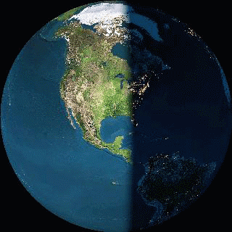
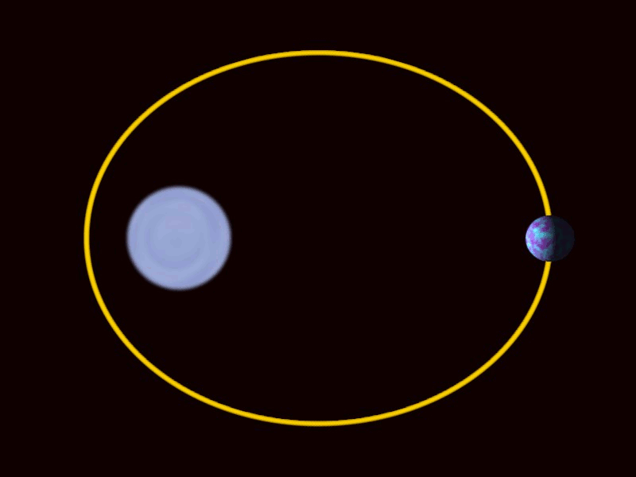
What’s the difference between rotation and revolution?

Slide 3
Repeat the opposite word/phrase.
GEOCENTRIC
EARTH-CENTRED

Slide 4
Repeat the opposite word/phrase.
HELIOCENTRIC
SUN-CENTRED

Slide 5
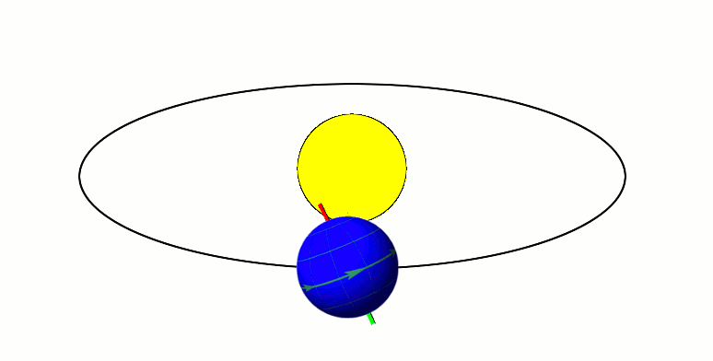
Draw a diagram of the southern hemisphere experiencing:
Summer
Winter

Slide 6
Which list below are mixtures?
Which list below are pure substances?
List A | List B
Pure sugar | Sea water
Pure water | Tap water
Salt | Cordial
Gold | Oil and water
Diamond | Salad

Slide 7
We will model the movements of Earth, the sun and the moon during phases of the moon
TRACK WITH ME
READ WITH ME
We will identify the eight phases of the moon.
We will identify the phase of the moon based on the locations of the moon and the sun in comparison to the Earth
DECLARE THE OBJECTIVE
Read the learning objective to your partner.
Notes:
Learning Objectives contain concepts (nouns, big ideas), skills (verbs, measurable behaviours) and sometimes context (restricting or targeting conditions).
●Example: Students will be able to describe the concept of density and apply it to floating and sinking.
●
Success criteria are specific measurable outcomes that if met mean that the student has met the learning objective.
Examples:
•Students will be able to compare densities of substances using mass and volume.
•Students will be able to identify whether a solid or liquid will float or sink in a liquid based on their densities.

Slide 8
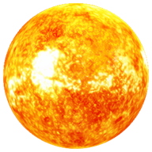

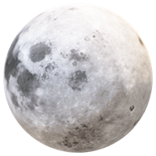
We will model the movements of Earth, the sun and the moon during phases of the moon
Write down as many things you know about the Sun, Moon and Earth.
SUN | MOON | EARTH
MAKE THE CONNECTION
Students, you already know that the Sun, the Moon and the Earth are part of the solar system. How have their revolutions and rotations affected our calendar?

Slide 9
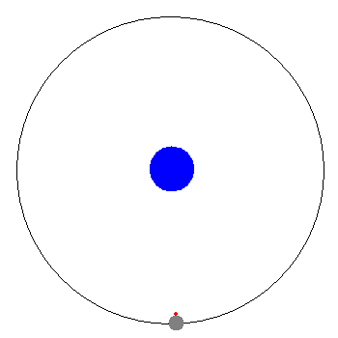
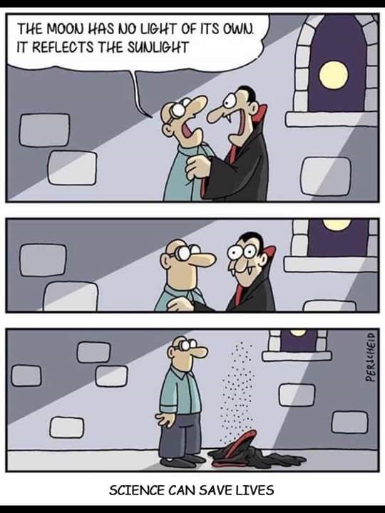
We will model the movements of Earth, the sun and the moon during phases of the moon
Unlike the Sun, the Moon does not produce its own light.
Instead, it reflects₁ sunlight.
We know that we always see the same side of the Moon from Earth because the Moon rotates₂ at the same speed as it orbits.
nts of the Earth, Sun & Moon during the phases of the moon
We will model the movements of the Earth, Sun & Moon during the phases of the moon
CHECK FOR UNDERSTANDING
Why do we always see the same side of the moon? Draw a diagram that includes the Sun, Earth and our Moon. Show how the Moon reflects sunlight.
VOCABULARY
1 - throw back light

Slide 10
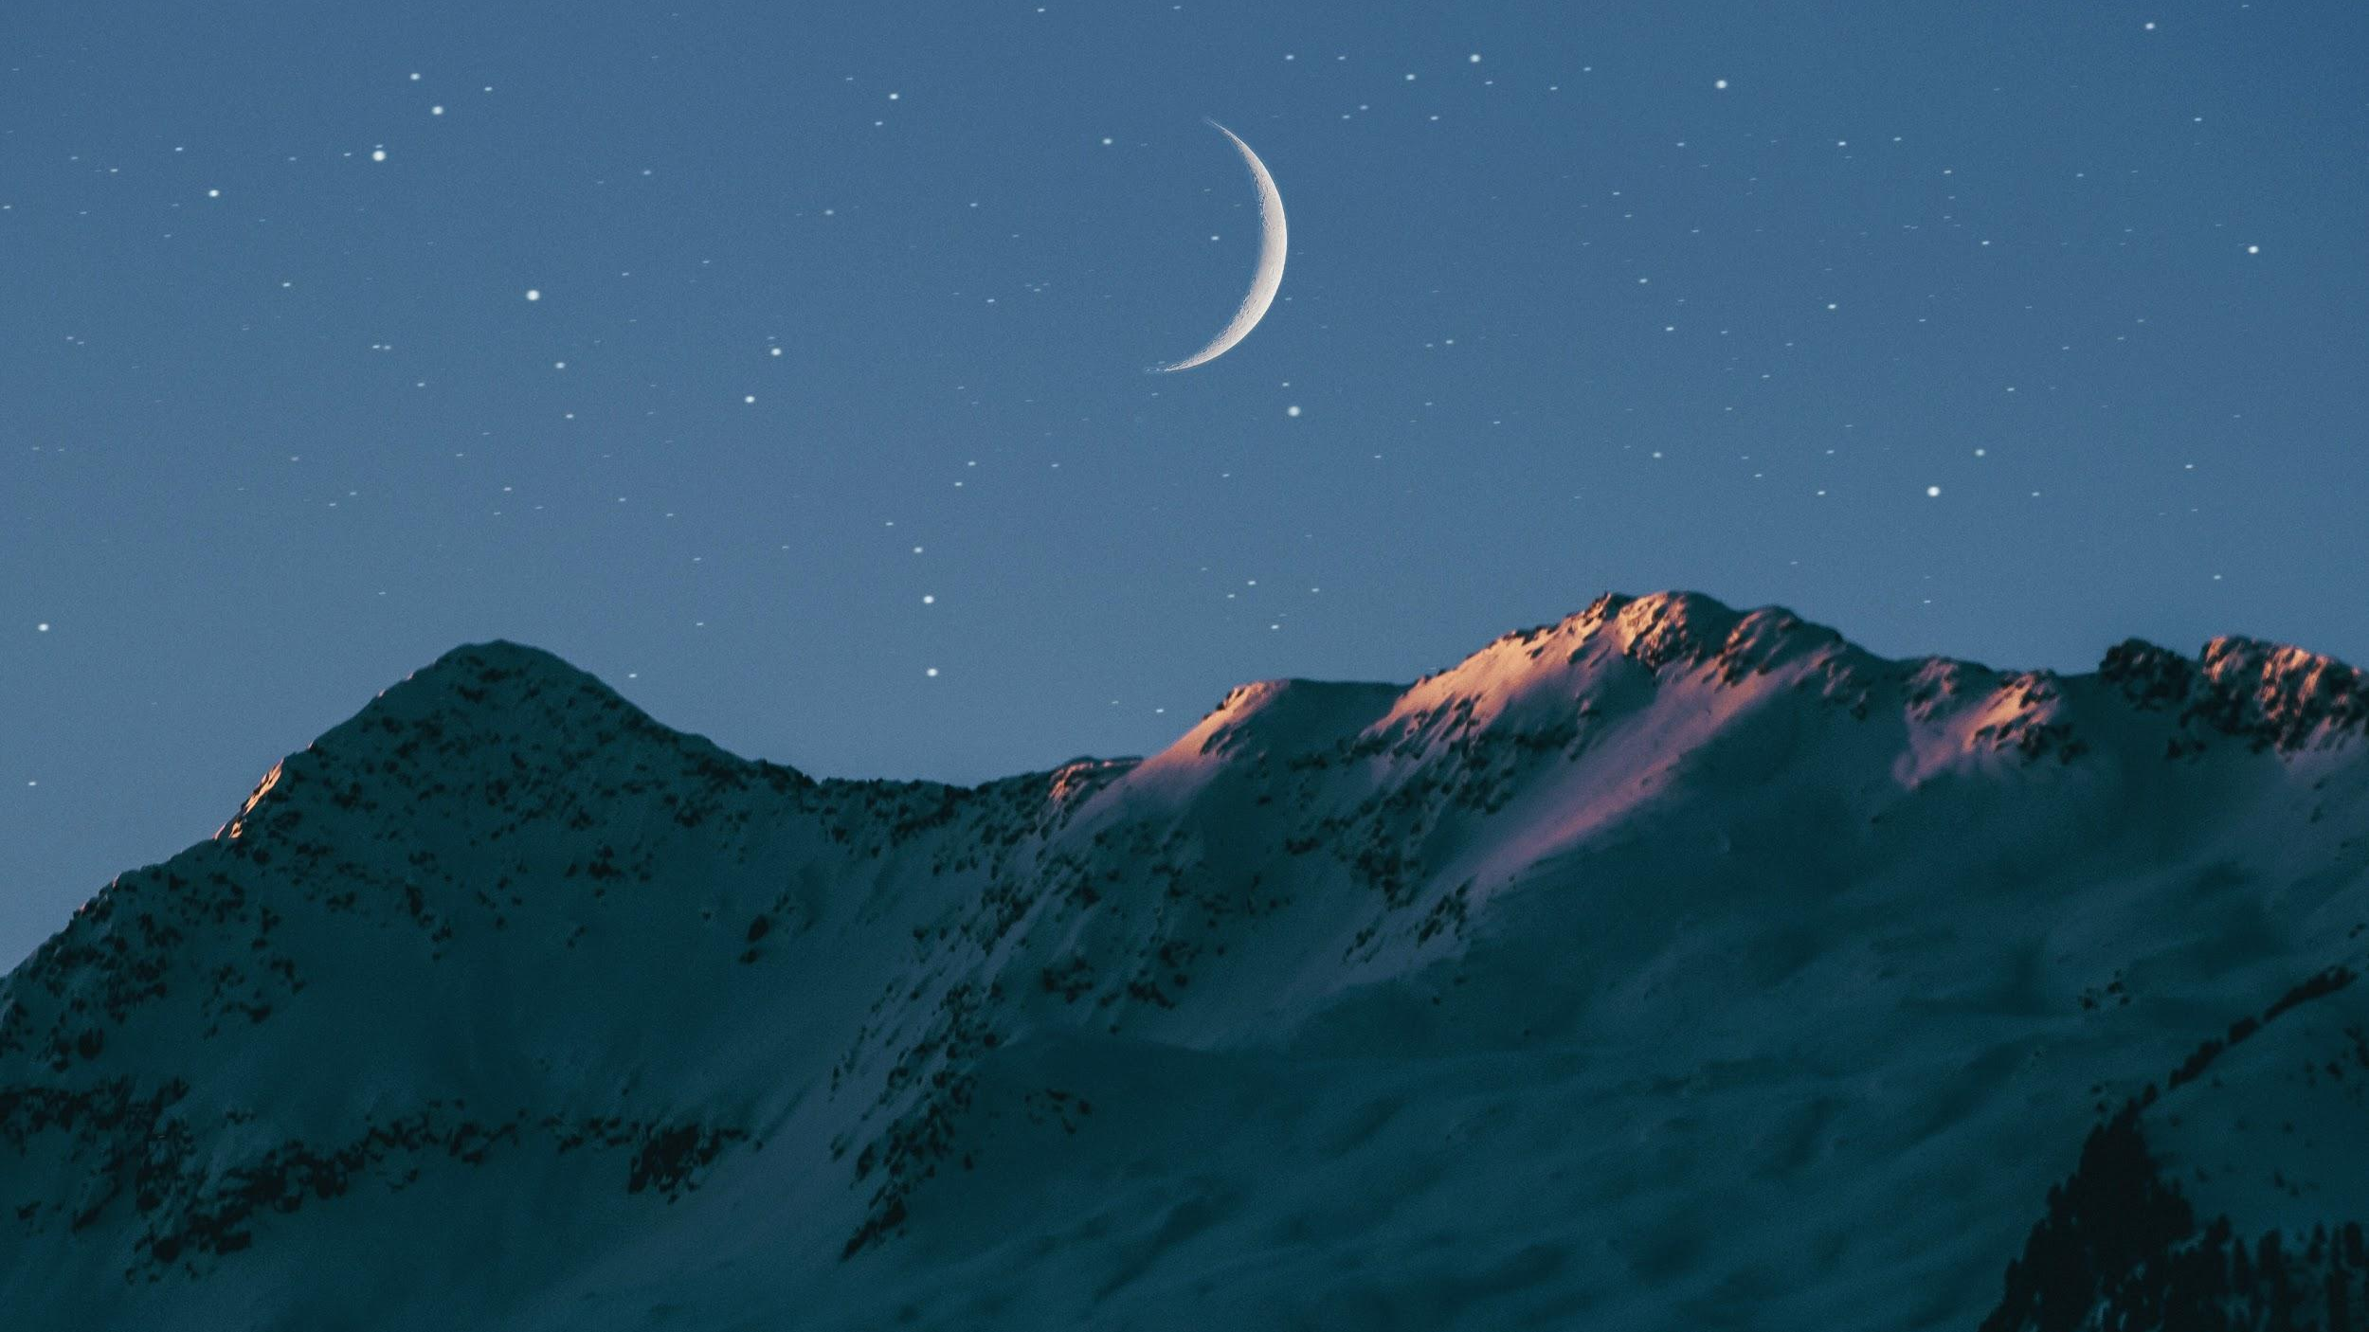
We will model the movements of Earth, the sun and the moon during phases of the moon
When we look at the Moon, sometimes you might see half a Moon, a crescent or a fully round moon.
These changes in shape of the Moon are called phases of the Moon - what changes is the amount of the Moon that is lit by the Sun.
CHECK FOR UNDERSTANDING
What causes the phases of the Moon? The colour of the moon. The amount of sunlight that is reflected off the Moon. The shape of the Moon. Explain.
VOCABULARY
1 - Earth centred 2 - stationary, not moving
Notes:
http://scaleofuniverse.com/
https://amazing-space.stsci.edu/resources/explorations/groundup/lesson/basics/g37/ - Image taken from

Slide 11
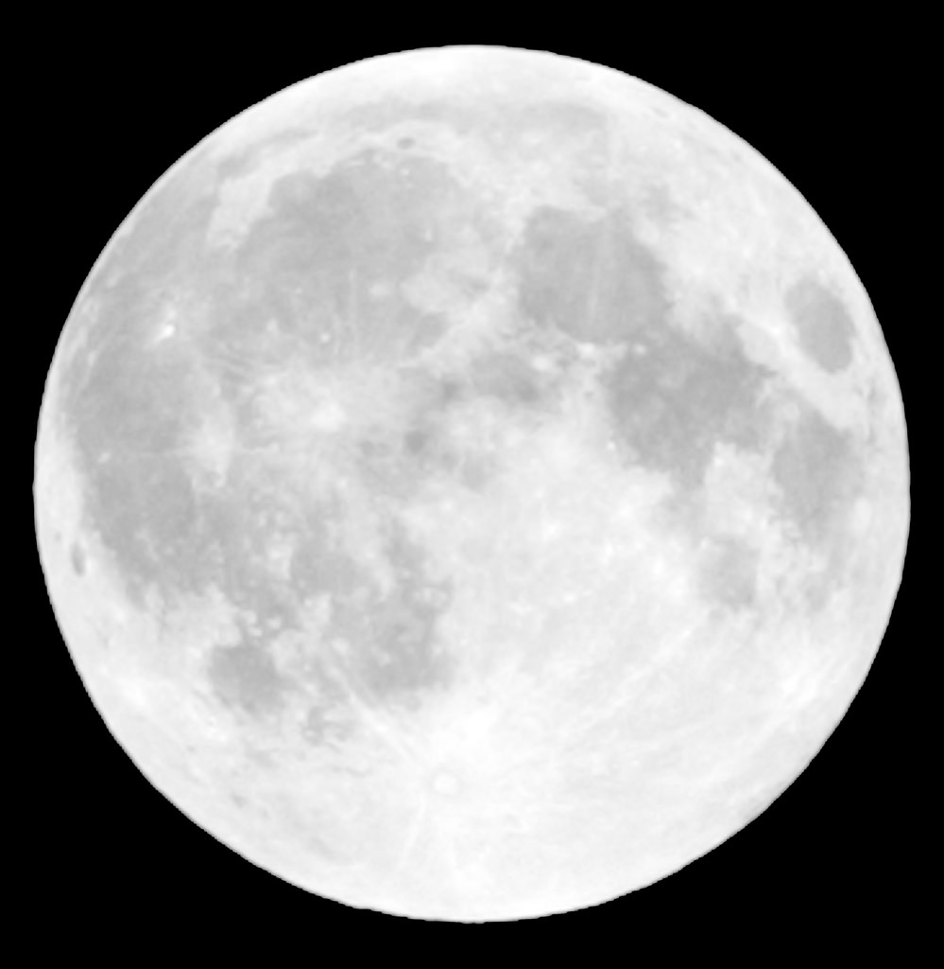
We will model the movements of Earth, the sun and the moon during phases of the moon
The phases of the moon can be explained by the light from the sun.
Waxing means the moon is becoming more lit by the sun.
Waning means the moon is becoming less lit by the sun.
CHECK FOR UNDERSTANDING
What is the difference between waxing and waning?
CHECK FOR UNDERSTANDING
Draw a waxing crescent Moon. How would a waning crescent Moon be different. It would be larger in size. It would change colour. It would be a reflection of the waxing crescent Moon.
Notes:
http://scaleofuniverse.com/
https://amazing-space.stsci.edu/resources/explorations/groundup/lesson/basics/g37/ - Image taken from

Slide 12

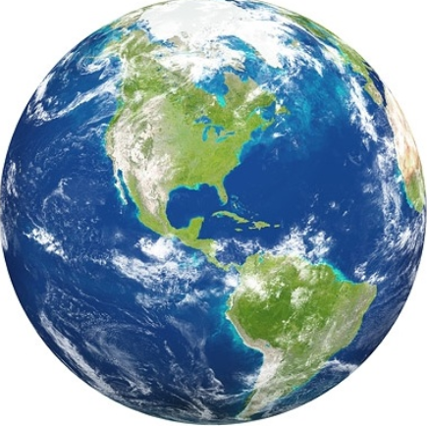

CHECK FOR UNDERSTANDING
Draw a waning crescent moon.
We will model the movements of Earth, the sun and the moon during phases of the moon
Look at the diagram on the right.
We would see a new moon.
New Waxing Crescent First Quarter Waxing Gibbous Full Waning Gibbous Third Quarter Waning Crescent

Slide 13
CHECK FOR UNDERSTANDING
Draw a third quarter moon.
We will model the movements of Earth, the sun and the moon during phases of the moon
Look at the diagram on the right.
We would see a waxing crescent.
New Waxing Crescent First Quarter Waxing Gibbous Full Waning Gibbous Third Quarter Waning Crescent

Slide 14
CHECK FOR UNDERSTANDING
Draw a first quarter moon.
We will model the movements of Earth, the sun and the moon during phases of the moon
Look at the diagram on the right.
We would see a first quarter.
New Waxing Crescent First Quarter Waxing Gibbous Full Waning Gibbous Third Quarter Waning Crescent

Slide 15
CHECK FOR UNDERSTANDING
Draw a waning gibbous moon.
We will model the movements of Earth, the sun and the moon during phases of the moon
Look at the diagram on the right.
We would see a full moon.
New Waxing Crescent First Quarter Waxing Gibbous Full Waning Gibbous Third Quarter Waning Crescent

Slide 16
REMEMBER THE CONCEPT
The moon does not create its own light instead it reflects sunlight The change in shape is caused by the amount of sunlight on the moon
We will model the movements of Earth, the sun and the moon during phases of the moon
Draw the diagram below
Shade and label the phase of the moon you would see
Sunlight
Sunlight

Slide 17
We will model the movements of Earth, the sun and the moon during phases of the moon
What is this phase of the moon?

Slide 18
We will model the movements of Earth, the sun and the moon during phases of the moon
What is this phase of the moon?
Full Moon

Slide 19
We will model the movements of Earth, the sun and the moon during phases of the moon
What is this phase of the moon?

Slide 20
We will model the movements of Earth, the sun and the moon during phases of the moon
What is this phase of the moon?
New Moon

Slide 21
We will model the movements of Earth, the sun and the moon during phases of the moon
What is this phase of the moon?

Slide 22
We will model the movements of Earth, the sun and the moon during phases of the moon
What is this phase of the moon?
Waxing Gibbous

Slide 23
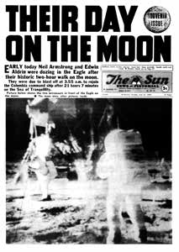
We will model the movements of Earth, the sun and the moon during phases of the moon
CHECK FOR UNDERSTANDING
Why would the moon affect our tides?
The Moon is the only body in space other than Earth where humans have actually stepped.
In 1969 Neil Armstrong and Buzz Aldrin were the first humans to walk on the Moon.
This event was televised live around the world.
The Moon has a significant impact on the Earth, it affects our tides and has a small gravitational pull on the Earth.

Slide 24
We will model the movements of Earth, the sun and the moon during phases of the moon
The Moon does not create its own light. It reflects sunlight from our Sun.
On Earth we see different phases of the moon because the amount of sunlight on the moon changes.
CHECK FOR UNDERSTANDING
Using the diagram below, draw the phase of the moon we would see? Name the phase you drew.

Slide 25
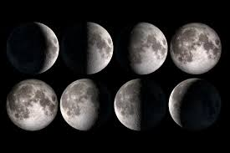
We will model the movements of Earth, the sun and the moon during phases of the moon
Complete the questions below.
What is the difference between waxing and waning?
Draw two examples of a crescent moon.
Using the diagram below, draw the phase of the moon we would see from Earth. Name the phase of the moon.
REMEMBER THE CONCEPT
Phases of the moon are caused by the amount of reflected light changing.
Notes:
Please include tasks/questions here rather than just referring to a worksheet. This will save on photocopying and facilitate sharing with other schools.
Try and build tasks/questions which escalate through Bloom’s Taxonomy. This will help with differentiation.

Slide 26
We will model the movements of Earth, the sun and the moon during phases of the moon
We will identify the eight phases of the moon.
We will identify the phase of the moon based on the locations of the moon and the sun in comparison to the Earth
CHECK FOR UNDERSTANDING
Check Success Criteria.

